Slide 1
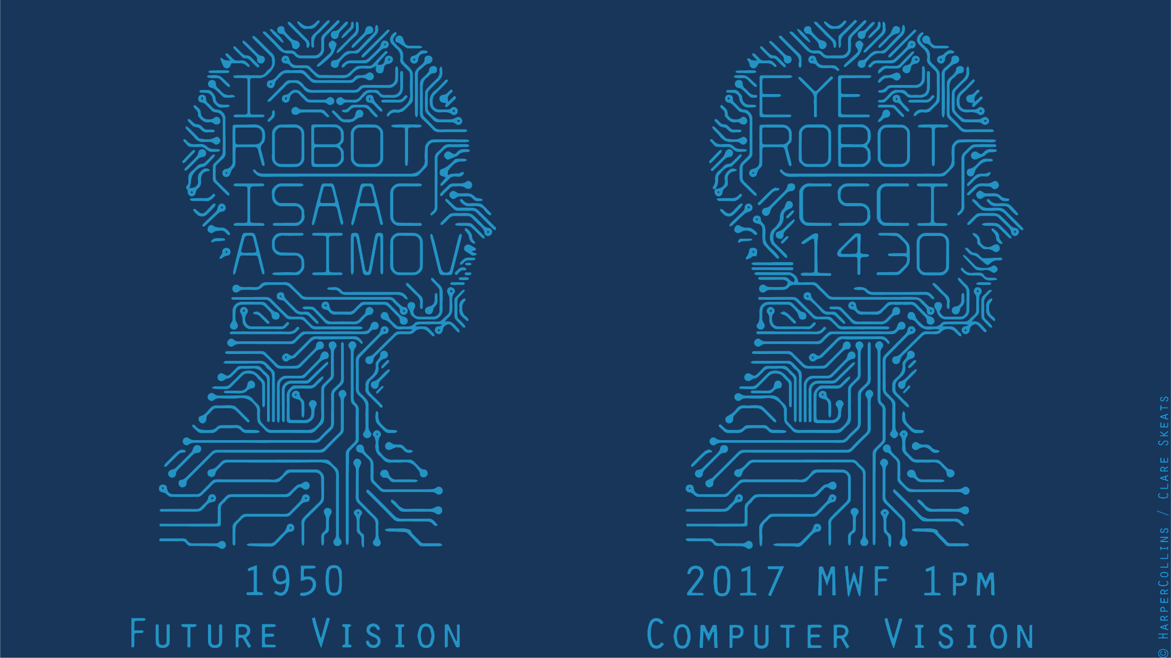
Notes:
Welcome to a class with some content!
Today we’re going to be discussing what an image is, and how light and color affect its formation.

Slide 2
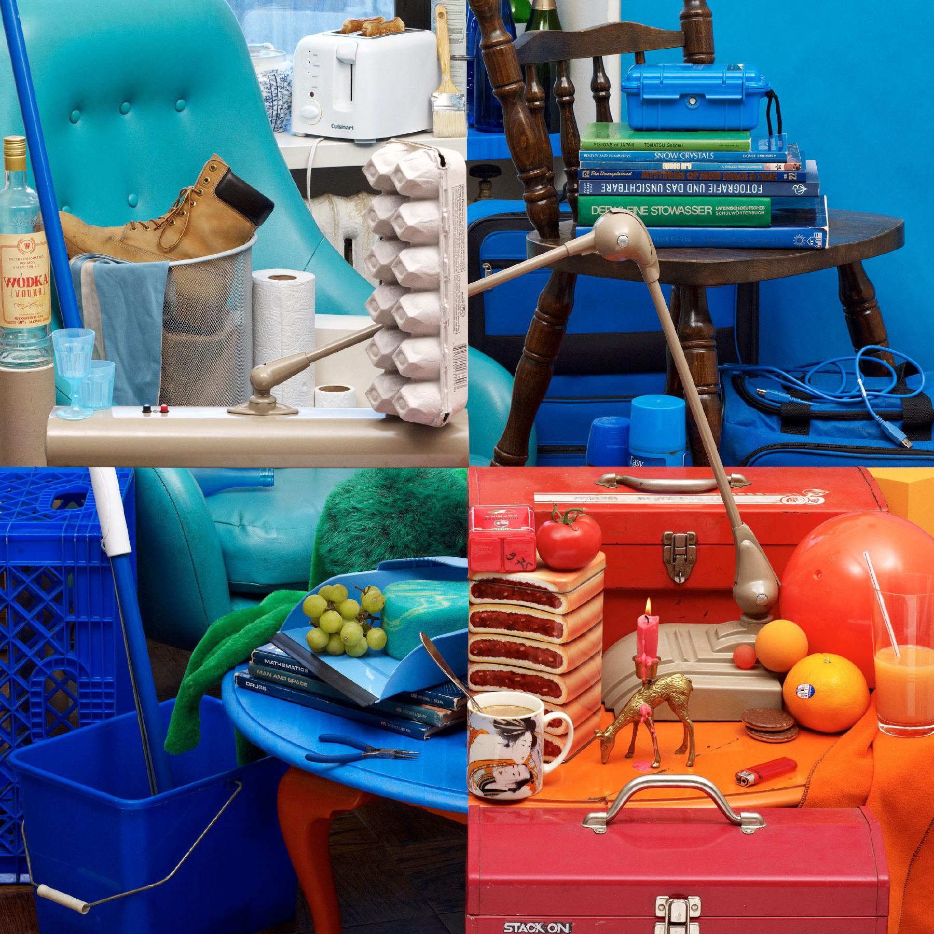
Bela Borsodi
Notes:
To start us off, let’s look at these four colorful images.
Think for a minute - what can you tell me about the differences between these images?
http://www.belaborsodi.com/

Slide 3
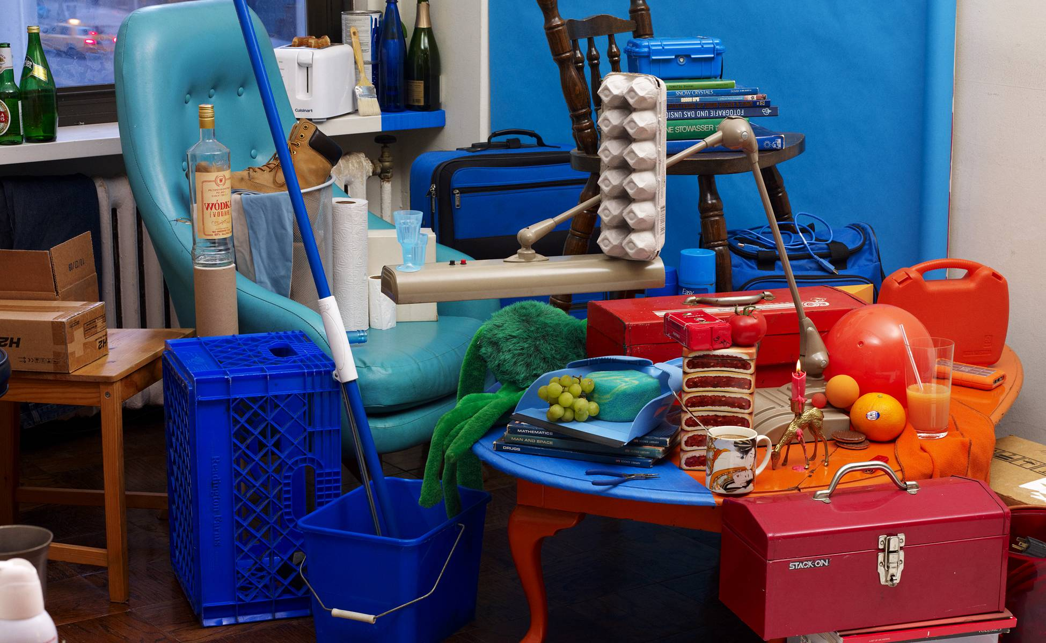
Bela Borsodi
Notes:
Major trick. The scene was arranged by looking through the viewfinder of the camera, which, as like the image, offers a fixed perspective which makes this possible.
http://youtube.com/watch?v=oJGN6sX5Ekg
Later on, we’re going to

Slide 4
Waitlist
We’ll let you know as soon as we can.
Biggest issue is TAs

Slide 5
CS 143 – James Hays
Many materials, courseworks, based from him + previous TA staff – serious thanks!

Slide 6
Reminder: the books
Lectures have associated readings
Szeliski 2.2 and 2.3 for today

Slide 7
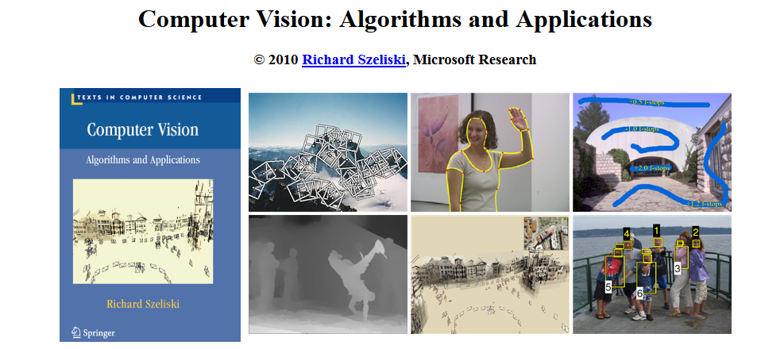
Textbook
http://szeliski.org/Book/

Slide 8
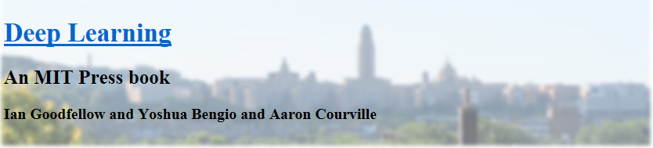

Textbook

Slide 9
Class experience
Linear algebra
Probability
Graphics course?
Vision/image processing course before?
Machine learning?

Slide 10
What Is an Image?

Slide 11
>> I = rand(256,256);
Think-Pair-Share:
What is this? What does it look like?
Which values does it take?
How many values can it take?
Is it an image?

Slide 12
>> I = rand(256,256);
>> imshow(I);
Danny Alexander

Slide 13
Dimensionality of an Image
@ 8bit = 256 values ^ 65,536
Computer says ‘Inf’ combinations.
Some depiction of all possible scenes would fit into this memory.
Notes:
Zoran and Weiss: “In the context of this work, a natural image would be the result of taking an ordinary digital camera, pointing it somewhere in the world and pressing the shutter button.“

Slide 14
Dimensionality of an Image
@ 8bit = 256 values ^ 65,536
Computer says ‘Inf’ combinations.
Some depiction of all possible scenes would fit into this memory.
Computer vision as making sense of an extremely high-dimensional space.
Subspace of ‘natural’ images.
Deriving low-dimensional, explainable models.
Notes:
Zoran and Weiss: “In the context of this work, a natural image would be the result of taking an ordinary digital camera, pointing it somewhere in the world and pressing the shutter button.“

Slide 15

What is each part of an image?
y
x
Notes:
What is a pixel?

Slide 16
What is each part of an image?
Pixel -> picture element
‘138’
y
I(x,y)
x
Notes:
What is a pixel?

Slide 17
Image as a 2D sampling of signal
Signal: function depending on some variable with physical meaning.
Image: sampling of that function.
2 variables: xy coordinates
3 variables: xy + time (video)
‘Brightness’ is the value of the function for visible light
Can be other physical values too: temperature, pressure, depth …
Danny Alexander
Notes:
Danny Alexander, UCL

Slide 18
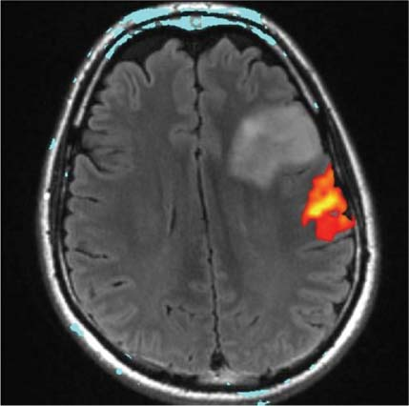
Example 2D Images
Danny Alexander
Notes:
fMRI - changes in blood flow in the brain associated with neural activity
http://radiologykey.com/wp-content/uploads/2016/01/9781604063325_c014_f004.jpg

Slide 19
Sampling in 1D
Sampling in 1D takes a function, and returns a vector whose elements are values of that function at the sample points.
Danny Alexander

Slide 20
Sampling in 2D
Sampling in 2D takes a function and returns a matrix.
Danny Alexander

Slide 21
Grayscale Digital Image
Brightness
or intensity
x
y
Danny Alexander

Slide 22
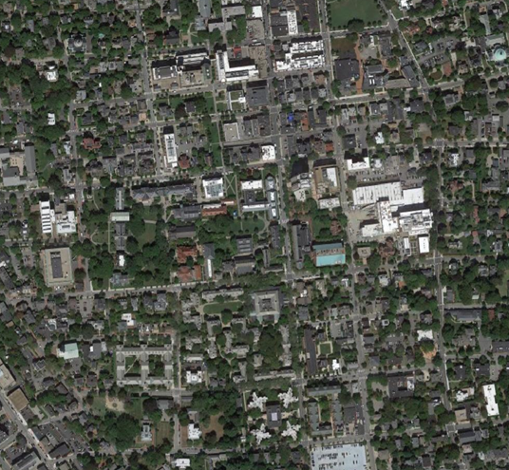
What is each part of a photograph?
Pixel -> picture element
‘127’
y
I(x,y)
x
Notes:
What is a pixel?

Slide 23


Integrating light over a range of angles.
Output Image
Camera Sensor
James Hays

Slide 24
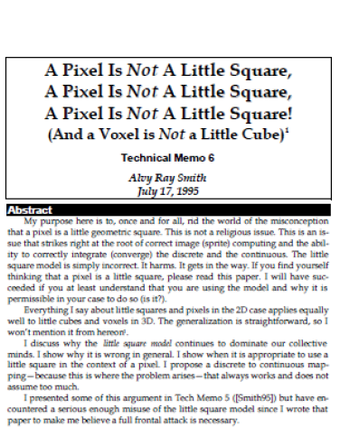
“A Pixel Is Not A Little Square, A Pixel Is Not A Little Square, A Pixel Is Not A Little Square! (And a Voxel is Not a Little Cube)”
Alvy Ray Smith,
MS Tech Memo 6, 1995.
Notes:
Perhaps a pixel is not a little square?

Slide 25

Resolution – geometric vs. spatial resolution
Both images are ~500x500 pixels
Notes:
What kinds of issues might cause this?
Difference between geometric resolution and spatial resolution.

Slide 26
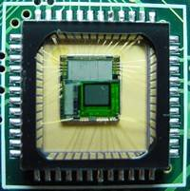
Sensor Array
CMOS sensor
James Hays

Slide 27
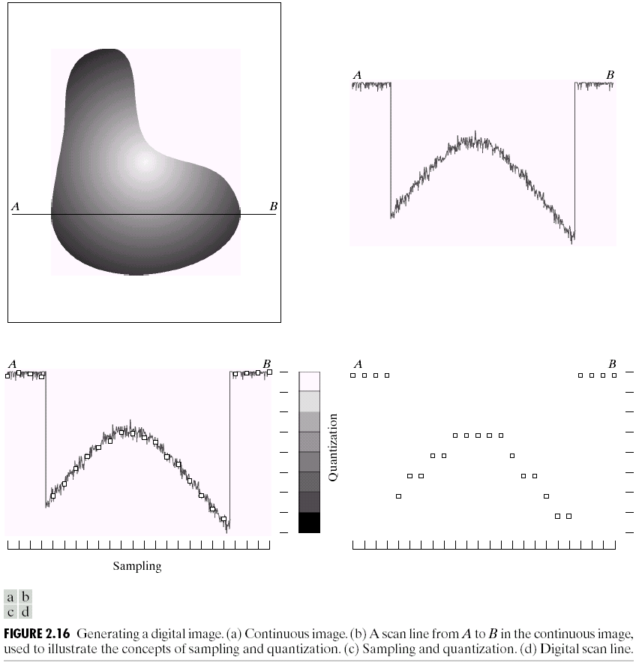
Quantization
James Hays
Notes:
Real valued function will get digital values – integer values
• Quantization is lossy!!
– After quantization, the original signal cannot be reconstructed anymore
• This is in contrast to sampling, as a sampled but not quantized signal can be reconstructed.
• Simple quantization uses equally spaced levels with k intervals

Slide 28




Quantization Effects – Radiometric Resolution
8 bit – 256 levels
4 bit – 16 levels
2 bit – 4 levels
1 bit – 2 levels

Slide 29
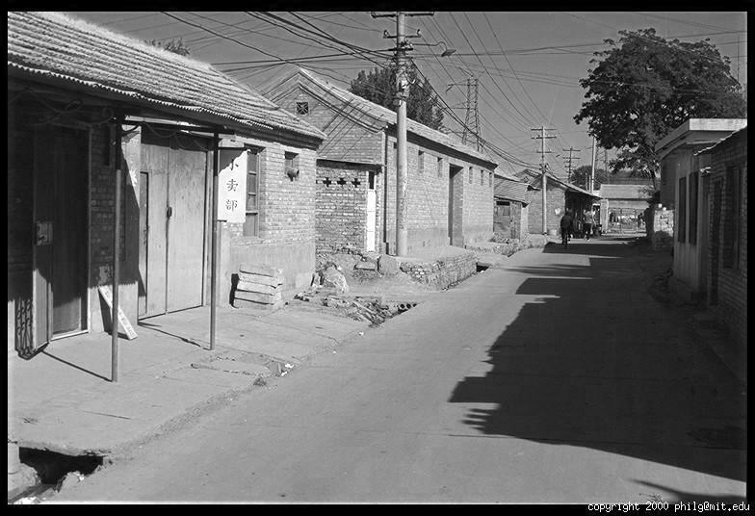
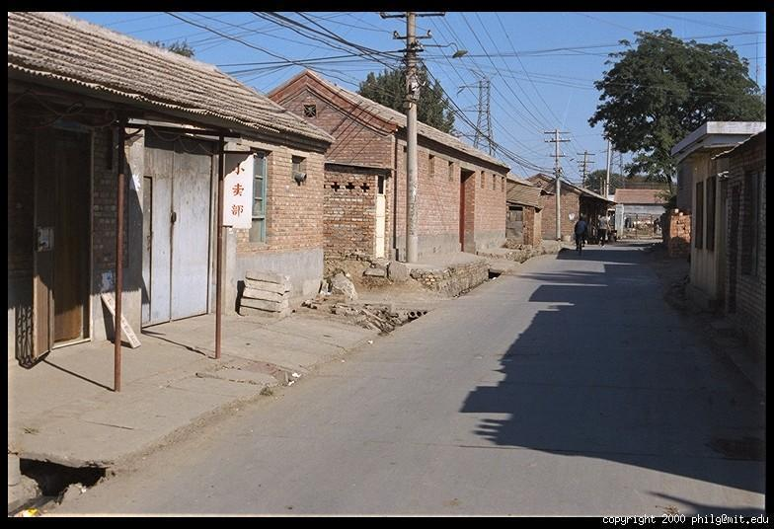
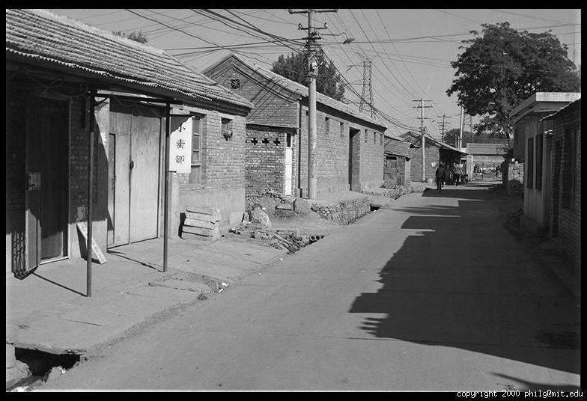
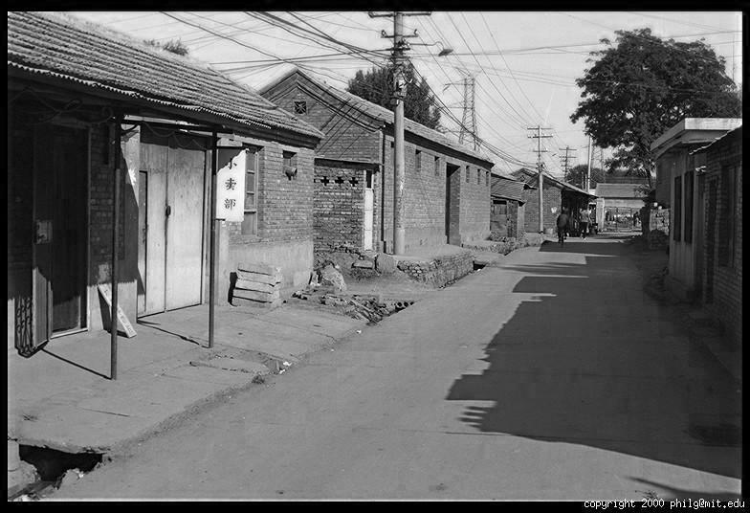
Color
R
G
B
James Hays

Slide 30
Images in Matlab
NxM RGB “im”
im(1,1,1) = top-left pixel value in R-channel
im(y, x, b) = y pixels down, x pixels to right in the b^{th} channel
im(N, M, 3) = bottom-right pixel in B-channel
imread(filename) returns a uint8 image (values 0 to 255)
Convert to double format (values 0 to 1) with im2double
column
row
R
0.92 | 0.93 | 0.94 | 0.97 | 0.62 | 0.37 | 0.85 | 0.97 | 0.93 | 0.92 | 0.99
0.95 | 0.89 | 0.82 | 0.89 | 0.56 | 0.31 | 0.75 | 0.92 | 0.81 | 0.95 | 0.91
0.89 | 0.72 | 0.51 | 0.55 | 0.51 | 0.42 | 0.57 | 0.41 | 0.49 | 0.91 | 0.92
0.96 | 0.95 | 0.88 | 0.94 | 0.56 | 0.46 | 0.91 | 0.87 | 0.90 | 0.97 | 0.95
0.71 | 0.81 | 0.81 | 0.87 | 0.57 | 0.37 | 0.80 | 0.88 | 0.89 | 0.79 | 0.85
0.49 | 0.62 | 0.60 | 0.58 | 0.50 | 0.60 | 0.58 | 0.50 | 0.61 | 0.45 | 0.33
0.86 | 0.84 | 0.74 | 0.58 | 0.51 | 0.39 | 0.73 | 0.92 | 0.91 | 0.49 | 0.74
0.96 | 0.67 | 0.54 | 0.85 | 0.48 | 0.37 | 0.88 | 0.90 | 0.94 | 0.82 | 0.93
0.69 | 0.49 | 0.56 | 0.66 | 0.43 | 0.42 | 0.77 | 0.73 | 0.71 | 0.90 | 0.99
0.79 | 0.73 | 0.90 | 0.67 | 0.33 | 0.61 | 0.69 | 0.79 | 0.73 | 0.93 | 0.97
0.91 | 0.94 | 0.89 | 0.49 | 0.41 | 0.78 | 0.78 | 0.77 | 0.89 | 0.99 | 0.93
G
0.92 | 0.93 | 0.94 | 0.97 | 0.62 | 0.37 | 0.85 | 0.97 | 0.93 | 0.92 | 0.99
0.95 | 0.89 | 0.82 | 0.89 | 0.56 | 0.31 | 0.75 | 0.92 | 0.81 | 0.95 | 0.91
0.89 | 0.72 | 0.51 | 0.55 | 0.51 | 0.42 | 0.57 | 0.41 | 0.49 | 0.91 | 0.92
0.96 | 0.95 | 0.88 | 0.94 | 0.56 | 0.46 | 0.91 | 0.87 | 0.90 | 0.97 | 0.95
0.71 | 0.81 | 0.81 | 0.87 | 0.57 | 0.37 | 0.80 | 0.88 | 0.89 | 0.79 | 0.85
0.49 | 0.62 | 0.60 | 0.58 | 0.50 | 0.60 | 0.58 | 0.50 | 0.61 | 0.45 | 0.33
0.86 | 0.84 | 0.74 | 0.58 | 0.51 | 0.39 | 0.73 | 0.92 | 0.91 | 0.49 | 0.74
0.96 | 0.67 | 0.54 | 0.85 | 0.48 | 0.37 | 0.88 | 0.90 | 0.94 | 0.82 | 0.93
0.69 | 0.49 | 0.56 | 0.66 | 0.43 | 0.42 | 0.77 | 0.73 | 0.71 | 0.90 | 0.99
0.79 | 0.73 | 0.90 | 0.67 | 0.33 | 0.61 | 0.69 | 0.79 | 0.73 | 0.93 | 0.97
0.91 | 0.94 | 0.89 | 0.49 | 0.41 | 0.78 | 0.78 | 0.77 | 0.89 | 0.99 | 0.93
B
0.92 | 0.93 | 0.94 | 0.97 | 0.62 | 0.37 | 0.85 | 0.97 | 0.93 | 0.92 | 0.99
0.95 | 0.89 | 0.82 | 0.89 | 0.56 | 0.31 | 0.75 | 0.92 | 0.81 | 0.95 | 0.91
0.89 | 0.72 | 0.51 | 0.55 | 0.51 | 0.42 | 0.57 | 0.41 | 0.49 | 0.91 | 0.92
0.96 | 0.95 | 0.88 | 0.94 | 0.56 | 0.46 | 0.91 | 0.87 | 0.90 | 0.97 | 0.95
0.71 | 0.81 | 0.81 | 0.87 | 0.57 | 0.37 | 0.80 | 0.88 | 0.89 | 0.79 | 0.85
0.49 | 0.62 | 0.60 | 0.58 | 0.50 | 0.60 | 0.58 | 0.50 | 0.61 | 0.45 | 0.33
0.86 | 0.84 | 0.74 | 0.58 | 0.51 | 0.39 | 0.73 | 0.92 | 0.91 | 0.49 | 0.74
0.96 | 0.67 | 0.54 | 0.85 | 0.48 | 0.37 | 0.88 | 0.90 | 0.94 | 0.82 | 0.93
0.69 | 0.49 | 0.56 | 0.66 | 0.43 | 0.42 | 0.77 | 0.73 | 0.71 | 0.90 | 0.99
0.79 | 0.73 | 0.90 | 0.67 | 0.33 | 0.61 | 0.69 | 0.79 | 0.73 | 0.93 | 0.97
0.91 | 0.94 | 0.89 | 0.49 | 0.41 | 0.78 | 0.78 | 0.77 | 0.89 | 0.99 | 0.93
James Hays

Slide 31
Anatomy
But what is color?

Slide 32
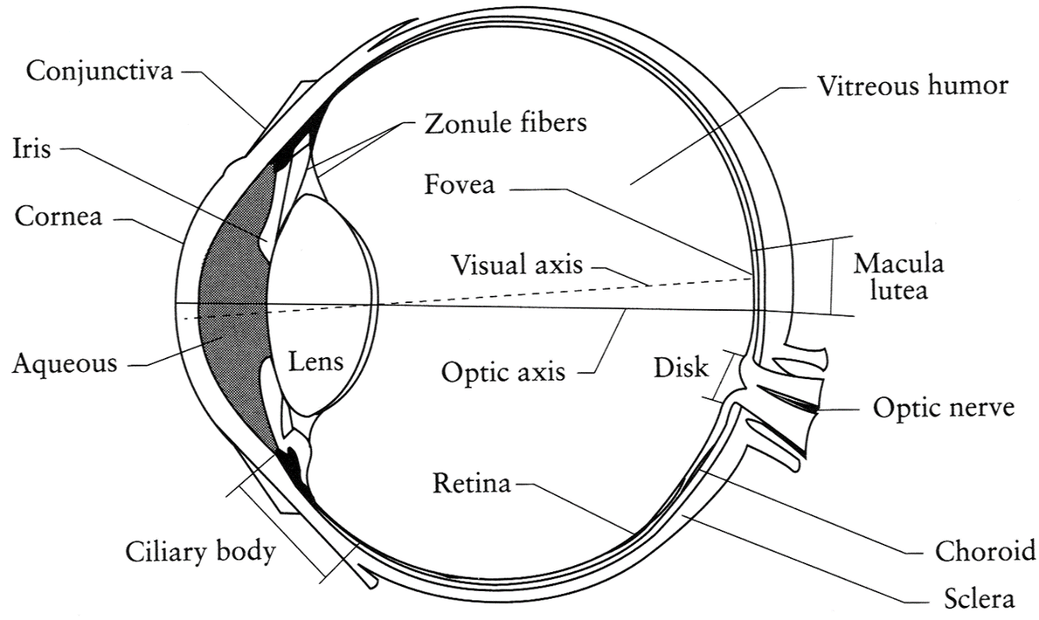
The Eye
The human eye is a camera
Iris - colored annulus with radial muscles
Pupil - the hole (aperture) whose size is controlled by the iris
What’s the sensor?
photoreceptor cells (rods and cones) in the retina
Slide by Steve Seitz

Slide 33
The Retina

Slide 34
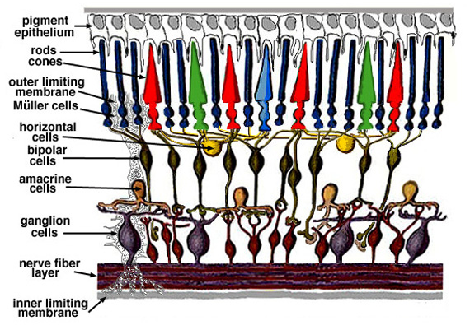
Retina up-close
Light
Notes:
Tapetum lucidum

Slide 35
Wait, the blood vessels are in front of the photoreceptors??
https://www.youtube.com/watch?v=L_W-IXqoxHA
Notes:
Yes, and you can see them!

Slide 36
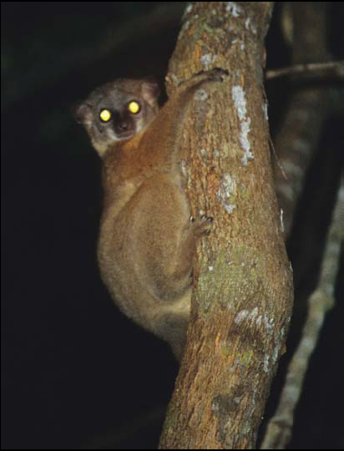
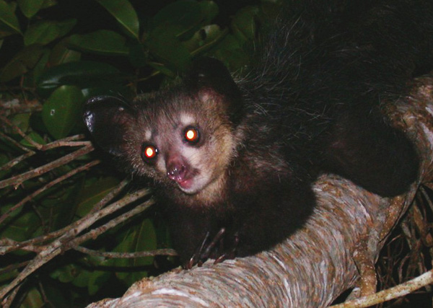
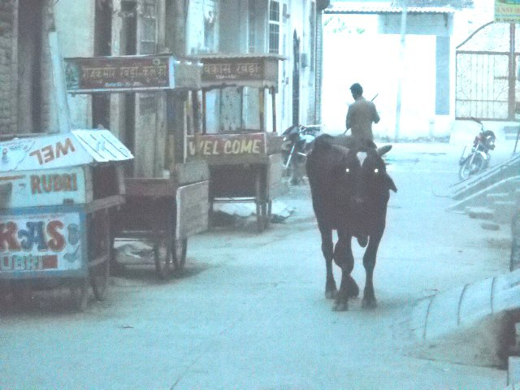
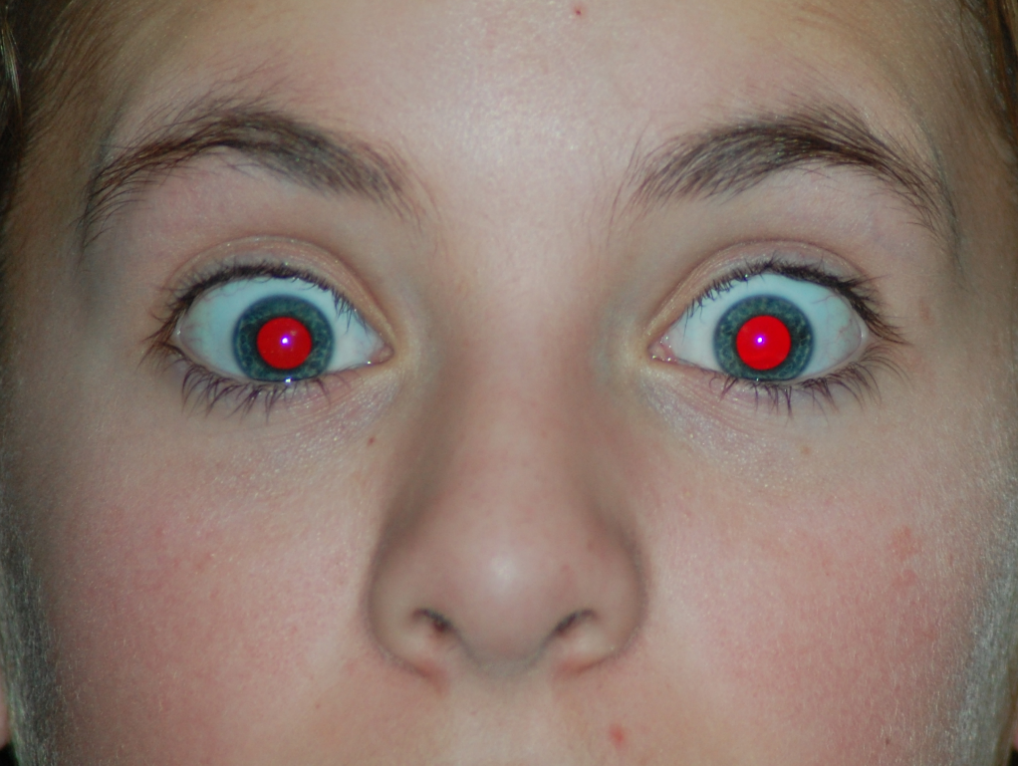
What humans don’t have: tapetum lucidum
Human eyes can reflect a tiny bit and blood in the retina makes this reflection red.
James Hays
Notes:
Animals with Tapetum Lucidum also have RPE, just not in the same part of the eye.
The tapetum lucidum /təˈpiːtəm/ (Latin: "bright tapestry; coverlet", plural tapeta lucida)^{[1]} is a layer of tissue in the eye of many vertebrates.^{[2]} Lying immediately behind the retina, it reflects visible light back through the retina, increasing the light available to the photoreceptors, though blurring the initial image of the light on focus. The tapetum lucidum contributes to the superior night vision of some animals. Many of these animals are nocturnal, especially carnivores that hunt their prey at night, while others are deep sea animals.

Slide 37
Two types of light-sensitive receptors
Cones
cone-shaped
less sensitive
operate in high light
color vision
Rods
rod-shaped
highly sensitive
operate at night
gray-scale vision
© Stephen E. Palmer, 2002
James Hays

Slide 38
Distribution of Rods and Cones
Night Sky: why are there more stars off-center? Averted vision: http://en.wikipedia.org/wiki/Averted_vision
© Stephen E. Palmer, 2002
James Hays

Slide 39
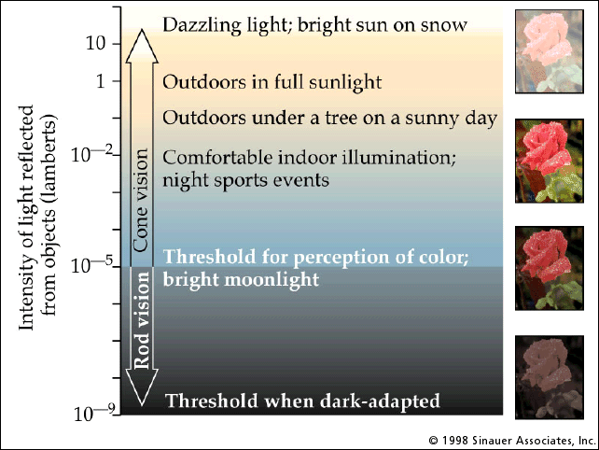
Rod / Cone sensitivity
Notes:
Motivation for HDR -> show range of intensity that an 8-bit image can capture.

Slide 40
Eye Movements
Saccades
Can be consciously controlled. Related to perceptual attention.
200ms to initiation, 20 to 200ms to carry out. Large amplitude.
Microsaccades
Involuntary. Smaller amplitude. Especially evident during prolonged fixation. Function debated.
Ocular microtremor (OMT)
involuntary. high frequency (up to 80Hz), small amplitude.
Smooth pursuit – tracking an object
James Hays

Slide 41
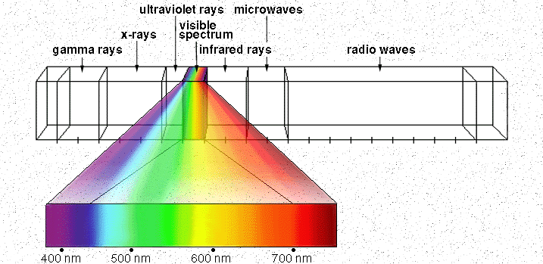
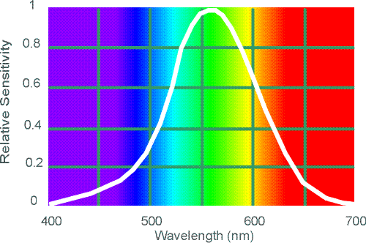
Electromagnetic Spectrum
Human Luminance Sensitivity Function
http://www.yorku.ca/eye/photopik.htm
Notes:
At least 3 spectral bands required (e.g. R,G,B)

Slide 42
Visible Light
Why do we see light of these wavelengths?
…because that’s where the
Sun radiates EM energy
© Stephen E. Palmer, 2002
Notes:
Because that’s where the Sun’s peak radiation was
Because the atmosphere is fairly transparent in that range
Because biology has many important markers in that range (but that’s because of the previous two reasons)

Slide 43
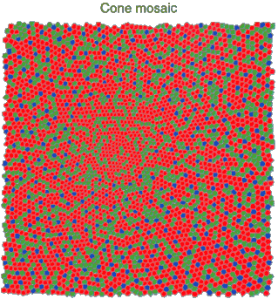
Physiology of Color Vision
Three kinds of cones:
© Stephen E. Palmer, 2002

Slide 44
The Physics of Light
Any patch of light can be completely described
physically by its spectrum: the number of photons
(per time unit) at each wavelength 400 - 700 nm.
© Stephen E. Palmer, 2002

Slide 45
The Physics of Light
Some examples of the spectra of light sources
© Stephen E. Palmer, 2002

Slide 46
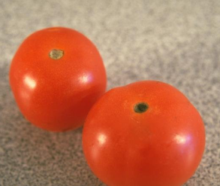
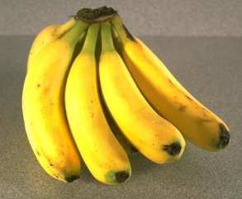
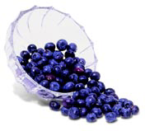
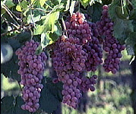
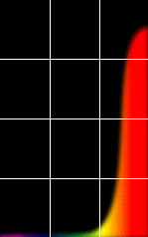
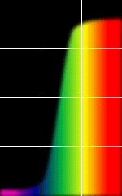
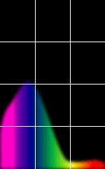
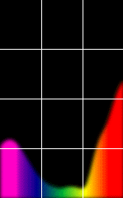
The Physics of Light
Some examples of the reflectance spectra of surfaces
Red
Yellow
Blue
Purple
% Photons Reflected
400 700
400 700
400 700
400 700
Wavelength (nm)
© Stephen E. Palmer, 2002

Slide 47
The Psychophysical Correspondence
There is no simple functional description for the perceived
color of all lights under all viewing conditions, but …...
A helpful constraint:
Consider only physical spectra with normal distributions
mean
area
variance
© Stephen E. Palmer, 2002

Slide 48
The Psychophysical Correspondence
Mean
Hue
# Photons
Wavelength
© Stephen E. Palmer, 2002

Slide 49
The Psychophysical Correspondence
Variance
Saturation
# Photons
Wavelength
© Stephen E. Palmer, 2002

Slide 50
The Psychophysical Correspondence
Area
Brightness
# Photons
Wavelength
© Stephen E. Palmer, 2002

Slide 51
Physiology of Color Vision
Three kinds of cones:
Why are M and L cones so close?
Why are there 3?
© Stephen E. Palmer, 2002

Slide 52


Impossible Colors
Can you make the cones respond in ways that typical light spectra never would?
http://en.wikipedia.org/wiki/Impossible_colors
James Hays

Slide 53
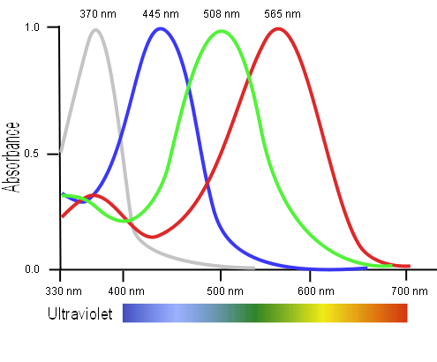
Tetrachromatism
Bird cone responses
Most birds, and many other animals, have cones for ultraviolet light.
Some humans seem to have four cones (12% of females).
True tetrachromatism is _rare_; requires learning.
James Hays
Notes:
http://www.sciencealert.com/scientists-have-found-a-woman-whose-eyes-have-a-whole-new-type-of-colour-receptor
Assuming that colour blind men pass this fourth cone cell onto their daughters, Mollon estimated that around 12 percent of the female population should be tetrachromats.
But all of his tests showed that these women could only perceive the same colours as the rest of us - which meant only three of their cone cell types were working, so they weren't true tetrachromats.

Slide 54
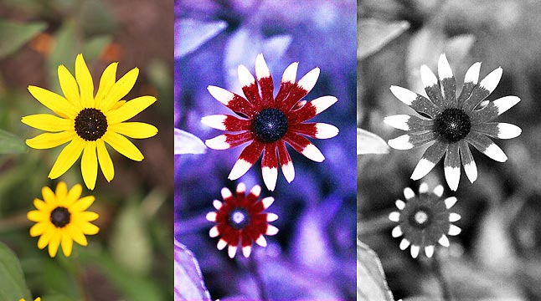
Bee vision
Notes:
Does color exist?
http://www.askamathematician.com/2012/06/q-do-colors-exist/
http://www.radiolab.org/story/211178-rip-rainbow/

Slide 55
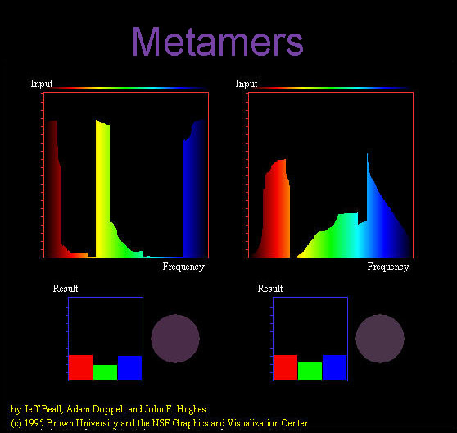
Notes:
Does color exist?

Slide 56
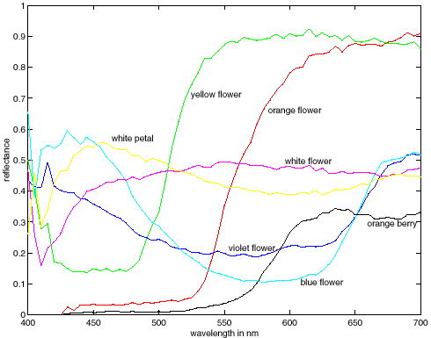
More Spectra
metamers
James Hays
Notes:
Metamerism can be illuminant based or observer based. Color blindness produced well known instances of metamerism.

Slide 57
What is color? Why do we even care about human vision in this class?
Notes:
Does color exist?

Slide 58
Why do we care about human vision?
We don’t, necessarily.
But biological vision shows that it is possible to make important judgements from images.
James Hays

Slide 59
Why do we care about human vision?
We don’t, necessarily.
But biological vision shows that it is possible to make important judgements from images.
It’s a human world -> cameras imitate the frequency response of the human eye to try to see as we see.

Slide 60
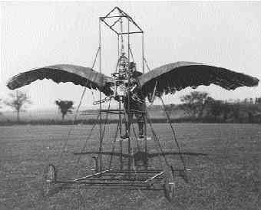
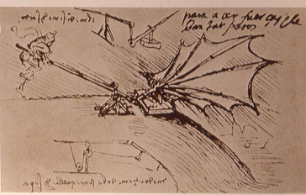
Ornithopters
James Hays

Slide 61
"Can machines fly like a bird?" No, because airplanes don’t flap.
"Can machines fly?" Yes, but airplanes use a different mechanism.
"Can machines perceive?" Is this question like the first, or like the second?
Adapted from Peter Norvig
Notes:
Norvig – director of research at Google; Brown alumnus (applied math)

Slide 62
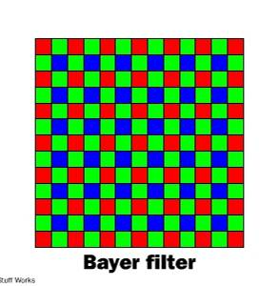
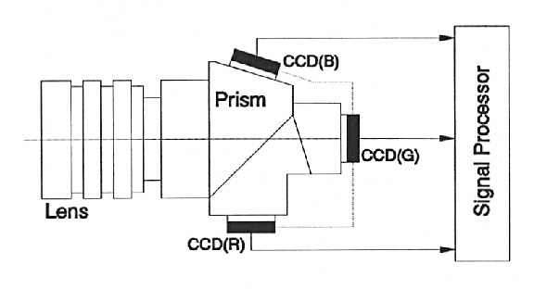
Color Sensing in Camera (RGB)
3-chip vs. 1-chip: quality vs. cost
Why more green?
Why 3 colors?
http://www.cooldictionary.com/words/Bayer-filter.wikipedia
Slide by Steve Seitz

Slide 63
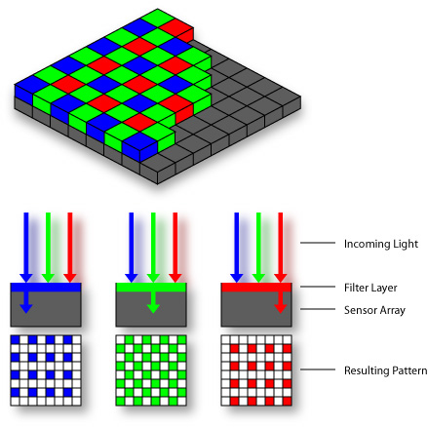

Practical Color Sensing: Bayer Grid
Estimate RGB at ‘G’ cells from neighboring values
Slide by Steve Seitz

Slide 64
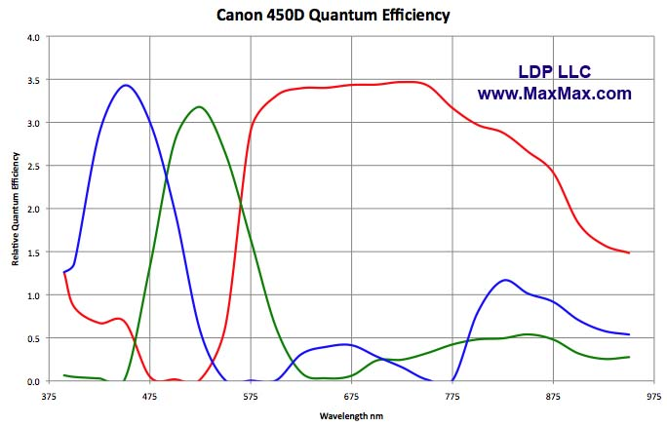
Camera Color Response
MaxMax.com
Notes:
https://www.quora.com/Why-is-there-a-significant-difference-between-image-sensors-and-human-eyes-Spectral-response
http://www.maxmax.com/ndvi_camera_technical.htm
http://www.maxmax.com/faq/camera-tech/spectral-response
NOTE the strong response into long wavelengths (near IR). Many camera sensors can see into infrared range, but the lens system includes an IR low-pass filter which blocks incoming IR light.

Slide 65
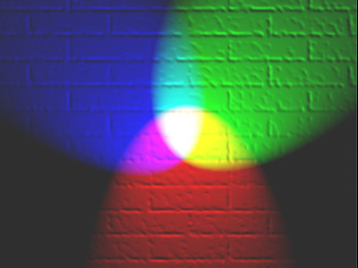
Color spaces
How can we represent color?
http://en.wikipedia.org/wiki/File:RGB_illumination.jpg

Slide 66

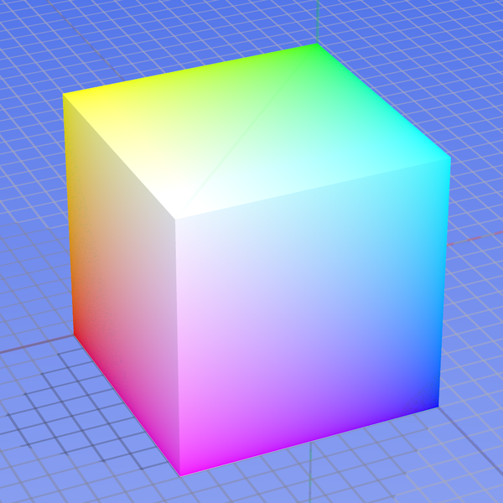
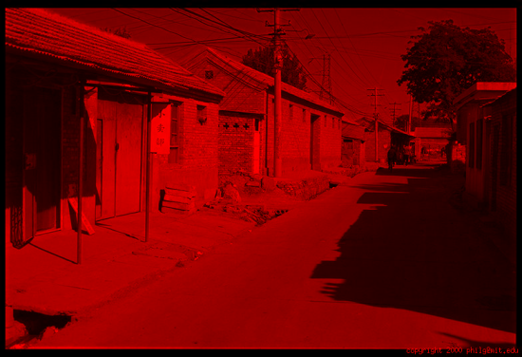
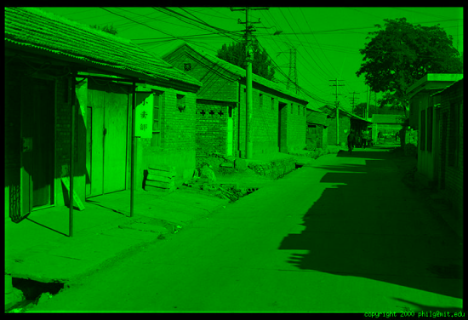
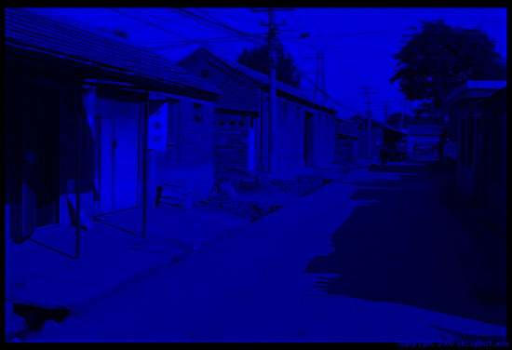
Color spaces: RGB
Default color space
0,1,0
R = 1
(G=0,B=0)
1,0,0
G = 1
(R=0,B=0)
0,0,1
B = 1
(R=0,G=0)
Any color = r*R + g*G + b*B
Strongly correlated channels
Non-perceptual
Image from: http://en.wikipedia.org/wiki/File:RGB_color_solid_cube.png

Slide 67
Is color a vector space? Think-Pair-Share
Got it. C = r*R + g*G + b*B
Notes:
https://arcsecond.wordpress.com/2008/10/06/calculoergosum/
Has certain properties of vector spaces, e.g., we can make a new basis from a different set of colors, like cyan, magenta, and yellow for instance.
But, it’s clamped at 1, and it doesn’t have negative values.

Slide 68
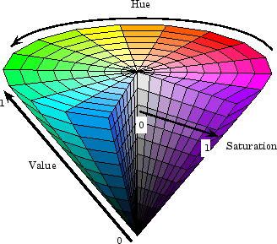
Color spaces: HSV
Intuitive color space

Slide 69
If you had to choose, would you rather go without: - intensity (‘value’), or - hue + saturation (‘chroma’)? Think-Pair-Share
James Hays
Notes:
Think Pair Share

Slide 70
If you had to choose, would you rather go without luminance or chrominance?

Slide 71
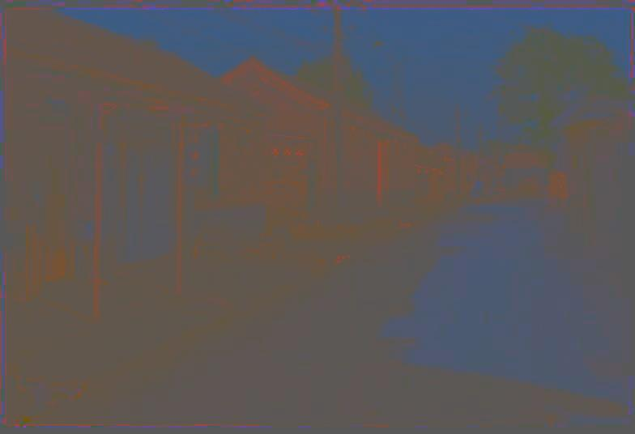
Most information in intensity
Only color shown – constant intensity
James Hays

Slide 72
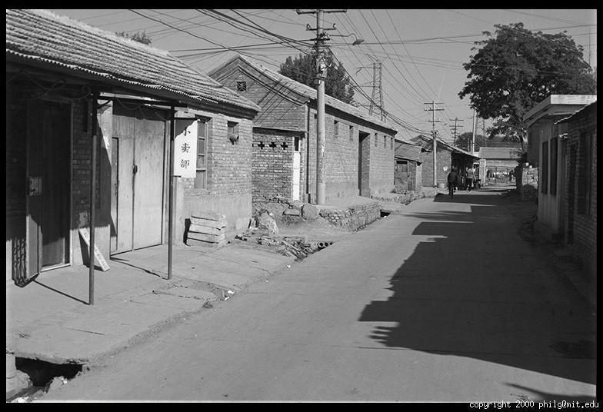
Most information in intensity
Only intensity shown – constant color
James Hays

Slide 73
Most information in intensity
Original image
James Hays

Slide 74



Color spaces: HSV
Intuitive color space
H
(S=1,V=1)
S
(H=1,V=1)
V
(H=1,S=0)
James Hays

Slide 75






Color spaces: YCbCr
Fast to compute, good for compression, used by TV
Y=0
Y=0.5
Y
(Cb=0.5,Cr=0.5)
Cr
Cb
(Y=0.5,Cr=0.5)
Cb
Y=1
Cr
(Y=0.5,Cb=05)
James Hays
Notes:
The colorimetric difference between a given color in a television picture and a standard color of equal luminance.

Slide 76

Most JPEG images & videos subsample chroma
Notes:
http://users.wfu.edu/matthews/misc/jpg_vs_gif/JpgCompTest/

Slide 77

Notes:
Mapping linear scales to hue does not produce smooth perceptual changes.
It looks like there are sharp changes across these ranges, e.g., red, yellow, green, cyan, blue, purple.
Rainbow Color Map (Still) Considered Harmful
http://people.renci.org/~borland/pdfs/RainbowColorMap_VisViewpoints.pdf

Slide 78
Rainbow color map considered harmful
Borland and Taylor
Notes:
In actual fact, these are smooth uniformly increasing functions (gradients), with no such boundaries.
Rainbow Color Map (Still) Considered Harmful
http://people.renci.org/~borland/pdfs/RainbowColorMap_VisViewpoints.pdf

Slide 79
Is color perception a vector space?

Slide 80




Color spaces: L*a*b*
“Perceptually uniform”* color space
L
(a=0,b=0)
a
(L=65,b=0)
b
(L=65,a=0)
James Hays
Notes:
* almost

Slide 81
Why Does color look like it Maps smoothly to a circle?
“Intuitive” color space?
Wait a minute…

Slide 82
Project 0:
Tonight Sunlab 6pm-9pm
Next week: Project 1
Convolution
Filtering
Image Pyramids
Frequencies

Slide 83

XKCD

Slide 84
More references
https://www.colorsystem.com/
A description of many different color systems developed through history.
Navigate from the right-hand links.
Thanks to Alex Nibley!

Slide 85

Back to grayscale intensity
0.92 | 0.93 | 0.94 | 0.97 | 0.62 | 0.37 | 0.85 | 0.97 | 0.93 | 0.92 | 0.99
0.95 | 0.89 | 0.82 | 0.89 | 0.56 | 0.31 | 0.75 | 0.92 | 0.81 | 0.95 | 0.91
0.89 | 0.72 | 0.51 | 0.55 | 0.51 | 0.42 | 0.57 | 0.41 | 0.49 | 0.91 | 0.92
0.96 | 0.95 | 0.88 | 0.94 | 0.56 | 0.46 | 0.91 | 0.87 | 0.90 | 0.97 | 0.95
0.71 | 0.81 | 0.81 | 0.87 | 0.57 | 0.37 | 0.80 | 0.88 | 0.89 | 0.79 | 0.85
0.49 | 0.62 | 0.60 | 0.58 | 0.50 | 0.60 | 0.58 | 0.50 | 0.61 | 0.45 | 0.33
0.86 | 0.84 | 0.74 | 0.58 | 0.51 | 0.39 | 0.73 | 0.92 | 0.91 | 0.49 | 0.74
0.96 | 0.67 | 0.54 | 0.85 | 0.48 | 0.37 | 0.88 | 0.90 | 0.94 | 0.82 | 0.93
0.69 | 0.49 | 0.56 | 0.66 | 0.43 | 0.42 | 0.77 | 0.73 | 0.71 | 0.90 | 0.99
0.79 | 0.73 | 0.90 | 0.67 | 0.33 | 0.61 | 0.69 | 0.79 | 0.73 | 0.93 | 0.97
0.91 | 0.94 | 0.89 | 0.49 | 0.41 | 0.78 | 0.78 | 0.77 | 0.89 | 0.99 | 0.93

Slide 86

Proj 1: Image Filtering and Hybrid Images
Implement image filtering to separate high and low frequencies.
Combine high frequencies and low frequencies from different images to create a scale-dependent image.
James Hays

Slide 87

Digital camera
A digital camera replaces film with a sensor array
Each cell in the array is light-sensitive diode that converts photons to electrons
Two common types
Charge Coupled Device (CCD)
CMOS
http://electronics.howstuffworks.com/digital-camera.htm
Slide by Steve Seitz

Slide 88
A photon’s life choices
Absorption
Diffusion
Reflection
Transparency
Refraction
Fluorescence
Subsurface scattering
Phosphorescence
Interreflection
light source
λ
?
James Hays

Slide 89
A photon’s life choices
Absorption
Diffusion
Reflection
Transparency
Refraction
Fluorescence
Subsurface scattering
Phosphorescence
Interreflection
light source
λ
James Hays

Slide 90
A photon’s life choices
Absorption
Diffuse Reflection
Reflection
Transparency
Refraction
Fluorescence
Subsurface scattering
Phosphorescence
Interreflection
light source
λ
James Hays

Slide 91
A photon’s life choices
Absorption
Diffusion
Specular Reflection
Transparency
Refraction
Fluorescence
Subsurface scattering
Phosphorescence
Interreflection
light source
λ
James Hays

Slide 92
A photon’s life choices
Absorption
Diffusion
Reflection
Transparency
Refraction
Fluorescence
Subsurface scattering
Phosphorescence
Interreflection
light source
λ
James Hays

Slide 93
A photon’s life choices
Absorption
Diffusion
Reflection
Transparency
Refraction
Fluorescence
Subsurface scattering
Phosphorescence
Interreflection
light source
λ
James Hays

Slide 94
A photon’s life choices
Absorption
Diffusion
Reflection
Transparency
Refraction
Fluorescence
Subsurface scattering
Phosphorescence
Interreflection
light source
λ₁
λ₂
James Hays

Slide 95
A photon’s life choices
Absorption
Diffusion
Reflection
Transparency
Refraction
Fluorescence
Subsurface scattering
Phosphorescence
Interreflection
light source
λ
James Hays

Slide 96
A photon’s life choices
Absorption
Diffusion
Reflection
Transparency
Refraction
Fluorescence
Subsurface scattering
Phosphorescence
Interreflection
light source
t=1
t=n
James Hays

Slide 97
A photon’s life choices
Absorption
Diffusion
Reflection
Transparency
Refraction
Fluorescence
Subsurface scattering
Phosphorescence
Interreflection
light source
λ
(Specular Interreflection)
James Hays

Slide 98
Lambertian Reflectance
In computer vision, surfaces are often assumed to be ideal diffuse reflectors with no dependence on viewing direction.
James Hays

Slide 99



Interlace vs. progressive scan
http://www.axis.com/products/video/camera/progressive_scan.htm
Slide by Steve Seitz

Slide 100

Progressive scan
http://www.axis.com/products/video/camera/progressive_scan.htm
Slide by Steve Seitz

Slide 101

Interlace
http://www.axis.com/products/video/camera/progressive_scan.htm
Slide by Steve Seitz

Slide 102


Rolling Shutter
James Hays
Notes:
http://en.wikipedia.org/wiki/Rolling_shutter
Even DSLRs have this problem.

